Slide 1
Decision Making Using Conditional Statements
Practice Assignment

Slide 2
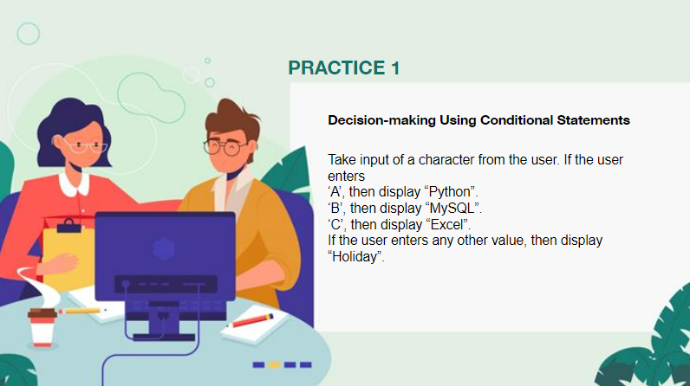

Slide 3
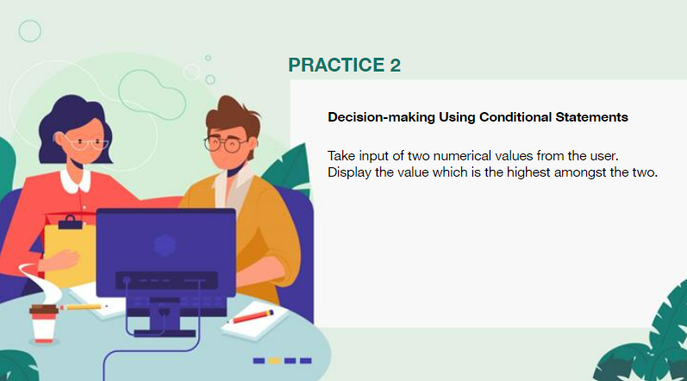

Slide 4
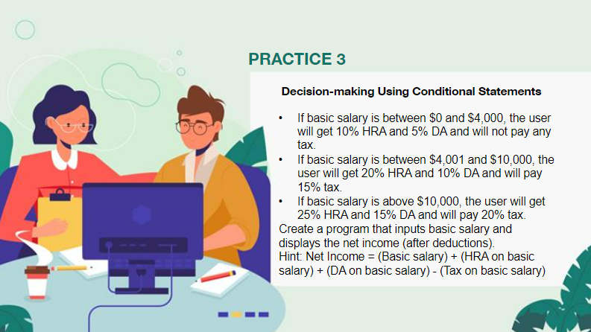

Slide 5
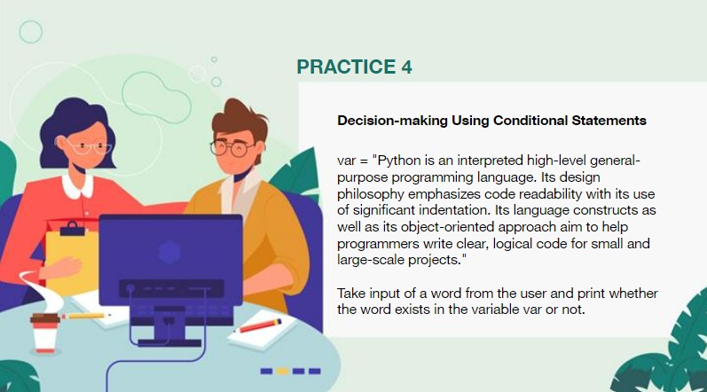

Slide 6

5

